Slide 1
RESTFul APIs

Slide 2
What is RESTFul API?
A RESTFul API is (a/an):
Application programming interface
Interface that uses HTTP requests to GET, PUT, POST & DELETE data
Interface that facilitates transferring representations & requests
Code that allows an application & resource to communicate with each other
System where there is a predefined protocol
System which uses standardized media types

Slide 3
Important Facts
HTTP Verbs are VERY important!
Headers generally contain the host name
Client and Server communication is stateless
Caching helps to increase server load
Client-Server Architecture
REST uses a layered system

Slide 4
How do RESTFul APIs work?
API uses HTTP requests to send & receive resources
Make processes reusable with minimal coding
Sends messages between clients and servers using a protocol
HTTP protocol is used
By using standardized meeting types
Standardization of representations

Slide 5
RESTFul API - HTTP Standards
GET - Get the resource
POST - Create a new resource
PUT - Replace the resource
DELETE - Delete the resource
PATCH - Modify parts of the resource
LINK - Connect the resource
OPTIONS - Different types of methods the resource can respond to

Slide 6
Website Communications
Application (browser) sends ‘GET’ request to the Server
Request asks server to send Information to the browser
Server sends the information back to browser
This shows the representation of the server
Browser sends another request if more information is required
If more information is needed a ‘POST’ request is sent
Server adds the POST request which then sends a new representation of the website

Slide 7
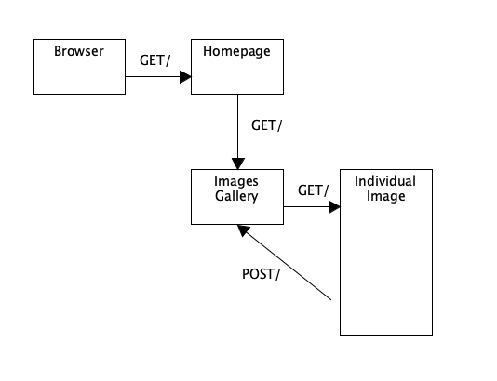
Drawing of Website Communication

Slide 8
RESTFul API Advantages
If there are alterations to resources the application isn’t affected
Variety of data formats are allowed (i.e. XML & JSON)
Automated service - so more efficient
Can be very flexible and allow many types of calls
It is a wide-spread standard
Better support with browsers and easier to work with

Slide 9
RESTFUL API Disadvantages
Might need to modify when going across firewalls
There isn’t a built-in system when communications fail
REST doesn’t integrate well with ACID transactions
Security - not as confidential or secure
There can be latency when using them
Can be more difficult for new developers to use

Slide 10
URI vs URL
Definition: URI - Uniform Resource Identifier & URL - Uniform Resource Locator
Cannot retrieve representations without a URL
If the resource isn’t identified by a URL, it is not able to fulfill fielding constraints
URI defines protocol for the resource
URL defines where the resource is obtained
URI does not access the resource

Slide 11
References
Pearlman, S. (2019, August 28). What are APIs and how do APIs work? Retrieved October 24, 2019, from https://blogs.mulesoft.com/biz/tech-ramblings-biz/what-are-apis-how-do-apis-work/ .
Stringfellow, A. (2017, April 27). SOAP vs. REST: Differences in Performance, APIs, and More - DZone Integration. Retrieved October 24, 2019, from https://dzone.com/articles/differences-in-performance-apis-amp-more.
BBVAOpen4U (Ed.). (2016, March 23). REST API: What is it, and what are its advantages in project development? Retrieved October 24, 2019, from https://bbvaopen4u.com/en/actualidad/rest-api-what-it-and-what-are-its-advantages-project-develpment.

